Slide 1
A Deeper Look Into Reactive Streams with Akka Streams 1.0
and Slick 3.0
Endre Varga, @drewhk — Akka Team

Slide 2
Outline
Reactive Streams
Slick 3
Akka Streams
Akka HTTP
Bringing it all together

Slide 3
Reactive Streams 1.0.0

Slide 4
Participants
Engineers from
Netflix
Pivotal
Red Hat
Typesafe
Individuals like Doug Lea and Todd Montgomery

Slide 5
Recipe for Success
minimal interfaces
rigorous specification of semantics
full TCK for verification of implementation
complete freedom for many idiomatic APIs

Slide 6
Supply and Demand
data items flow downstream
demand flows upstream
data items flow only when there is demand
recipient is in control of incoming data rate
data in flight is bounded by signaled demand
demand
Publisher
Subscriber
data
Notes:
the crucial addition is to make the exchange bidirectional, and explicitly so
message-passing between publisher and subscriber allows asynchronous non-blocking back pressure

Slide 7
Dynamic Push–Pull
“push” behavior when consumer is faster
“pull” behavior when producer is faster
switches automatically between these
batching demand allows batching data
demand
Publisher
Subscriber
data

Slide 8
Back-Pressure is Contagious
C is slow
B must slow down
A must slow down
A
B
C

Slide 9
Back-Pressure can be Propagated
TCP for example has it built-in
A
B
C
hosts
network

Slide 10
Reactive Streams
asynchronous non-blocking data flow
asynchronous non-blocking demand flow
minimal coordination and contention
message passing allows for distribution
across applications, nodes, CPUs, threads, actors

Slide 11
Slick 3.0
The Reactive Database Layer

Slide 12
Slick 3.0
Reactive API for accessing databases
Provides internal management for blocking JDBC access
Reactive frameworks/libraries can be used together with ordinary blocking database drivers
without sacrificing scalability and efficiency

Slide 13
Slick and Reactive Streams
On top of the usual database operations, a Reactive Streams implemenation for queries is implemented
Query results can now directly streamed in a non-blocking way
Allows integration with other Reactive Streams compliant libraries
(Akka Streams and Http, and many others)

Slide 14
Akka Streams

Slide 15
Declaring a Stream Topology

Slide 16
Declaring a Stream Topology

Slide 17
Declaring a Stream Topology

Slide 18
Declaring a Stream Topology

Slide 19
Declaring a Stream Topology

Slide 20
Declaring a Stream Topology

Slide 21
Declaring a Stream Topology

Slide 22
API Design
goals:
supreme compositionality
exhaustive model of bounded stream processing
consequences:
immutable and reusable stream blueprints
explicit materialization step
http://doc.akka.io/docs/akka-stream-and-http-experimental/1.0-RC2/stream-design.html

Slide 23
Materialization
Akka Streams separate the what from the how
declarative Source/Flow/Sink DSL to create blueprint
FlowMaterializer turns this into running Actors
this allows alternative materialization strategies
optimization
verification / validation
cluster deployment
only Akka Actors for now, but more to come!

Slide 24
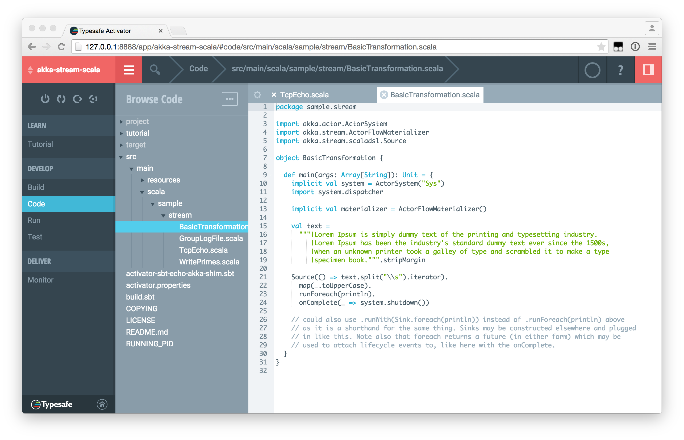
Akka Streams in Java 8 / Scala
Typesafe Activator: http://typesafe.com/get-started

Slide 25
Akka HTTP

Slide 26
Why do we add an HTTP module?
Akka is about building distributed applications
distribution implies integration
between internal (sub)systems ➜ akka-cluster based on akka-remote
with external systems or between microservices ➜ akka-http (lingua franca of the internet)

Slide 27
Akka HTTP—The Origins: Spray.IO
Fully embeddable HTTP stack based on Actors
focused on HTTP integration (toolkit)
server- and client-side
seamlessly integrated with Akka

Slide 28
Spray.IO Features
immutable, case class-based HTTP model
fast, lightweight HTTP client and server
powerful DSL for server-side API definition
fully async & non-blocking, actor-friendly, modular, testable
based entirely on Scala & Akka Actors

Slide 29
Spray.IO Weaknesses
some unintuitive corner-cases in routing DSL
deep implicit argument chains in some cases hard to debug
missing features, foremost websocket support
no Java API
handling of chunked requests is clunky, incomplete
dealing with large message entities can be difficult

Slide 30
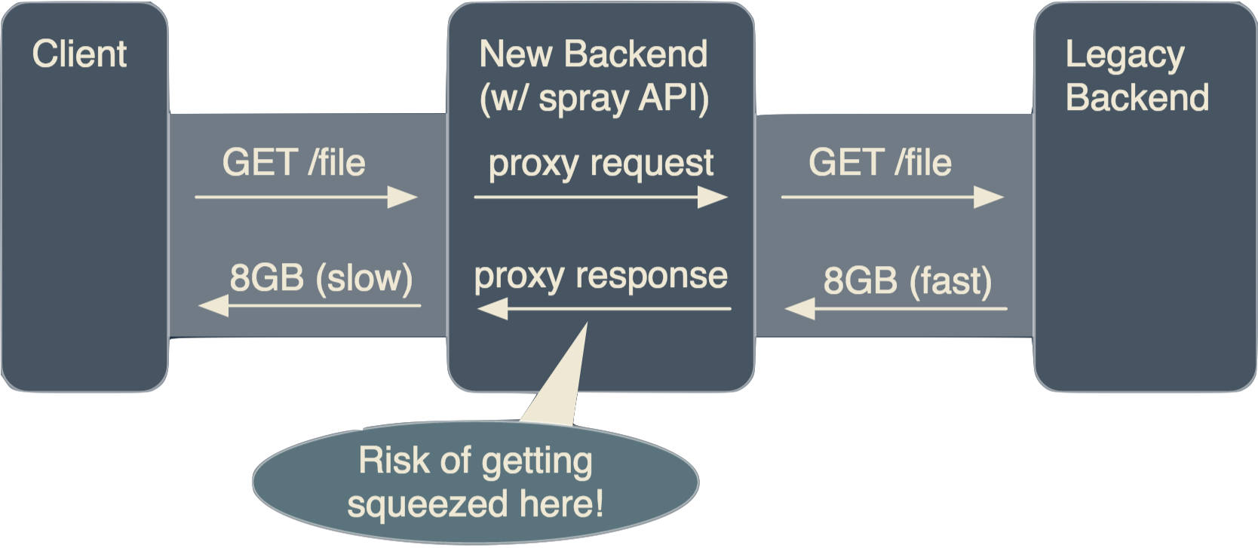
Proxying Large Responses

Slide 31
Akka HTTP is Spray 2.0
addressing the weaknesses, polishing the features
Java API
simplified module structure
core improvement: fully stream-based

Slide 32
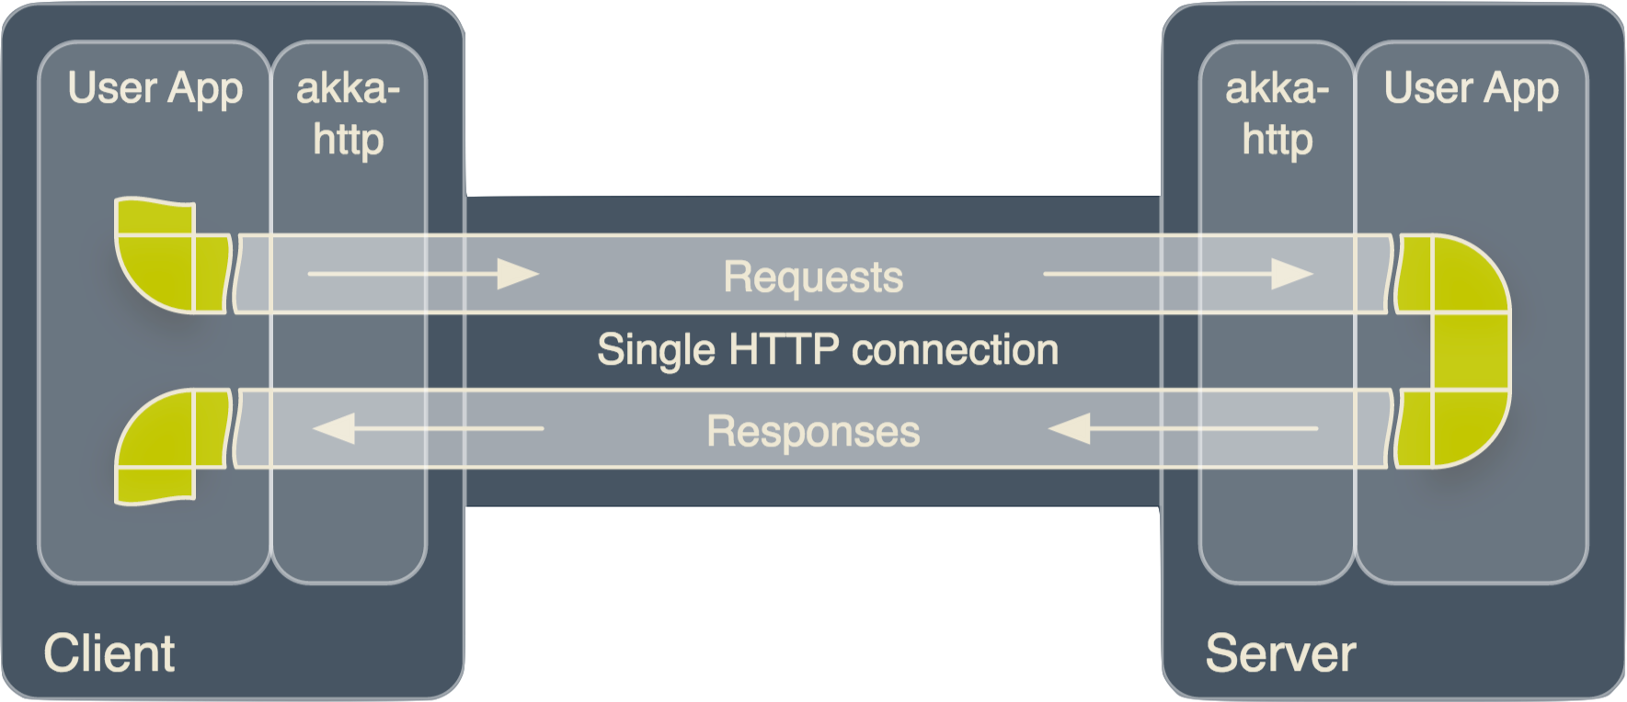
HTTP Stream Topology

Slide 33
Stream Pipelines
TCP
SSL/TLS
Requests
HTTP
App
Responses
optional

Slide 34
Bringing it all together

Slide 35
The Application Stack
application level
Akka HTTP
Slick 3.0
Akka HTTP Core
Database Driver
Akka Streams
Akka IO
Java NIO (JDK)
O/S-level network stack

Slide 36
More interesting stuff…
WEBINAR
HAVE QUESTIONS?
WHITEPAPER
Reactive for DevOps: A New Series
Get in touch with Typesafe today!
Getting Started with Apache Spark
REGISTER
CONTACT US
DOWNLOAD NOW

Slide 37
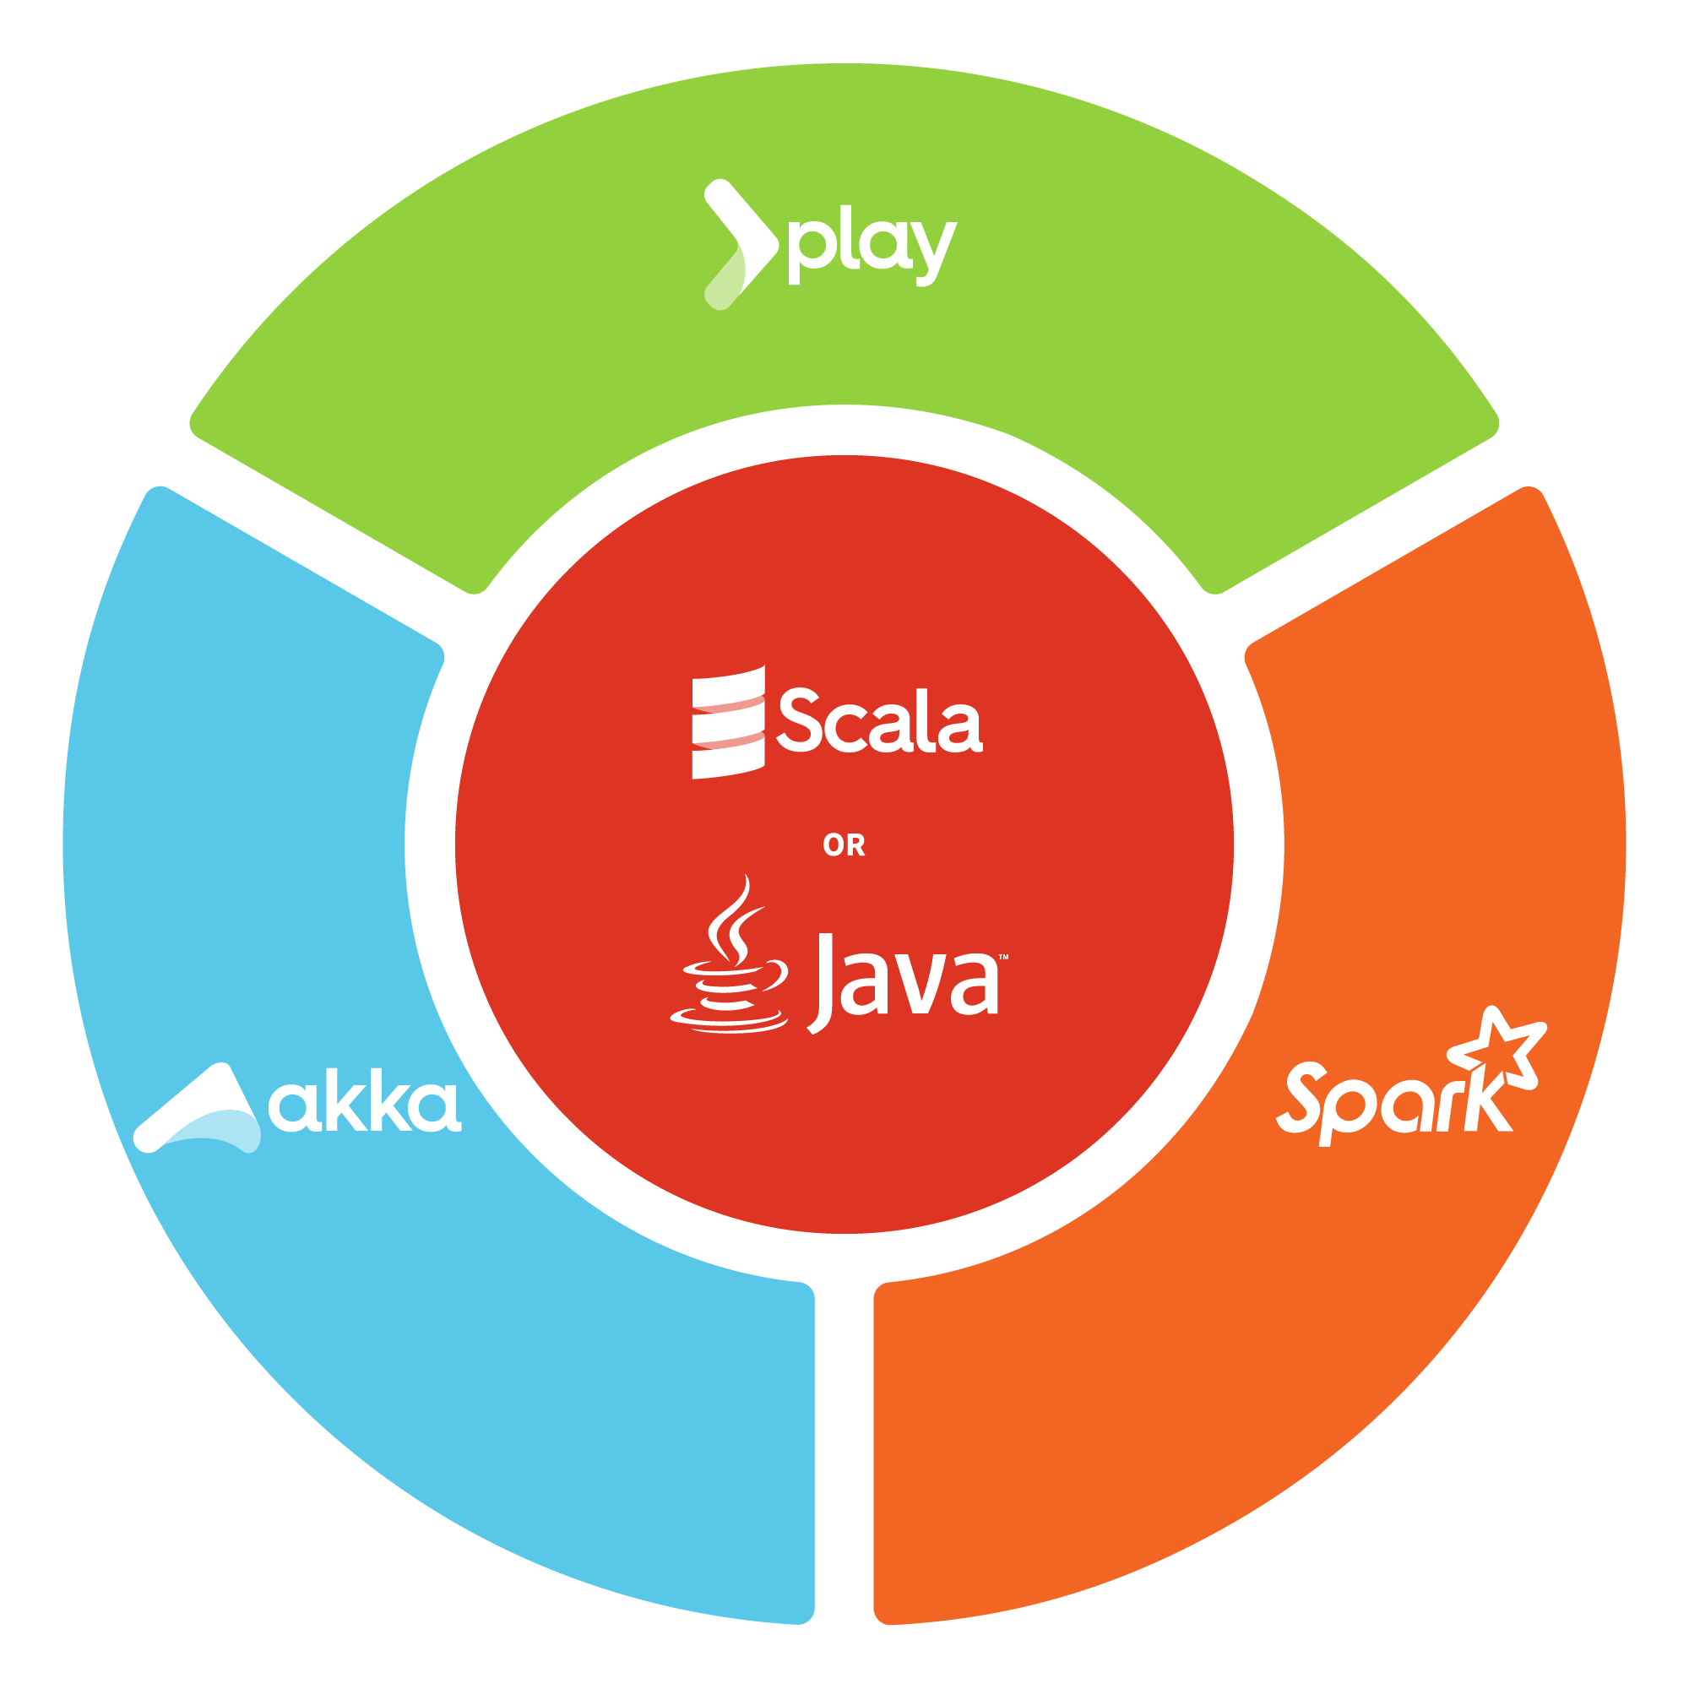
EXPERT TRAINING
Delivered on-site for Akka, Spark, Scala and Play
Help is just a click away. Get in touch with Typesafe about our training courses.
Intro Workshop to Apache Spark
Fast Track & Advanced Scala
Fast Track to Akka with Java or Scala
Fast Track to Play with Java or Scala
Advanced Akka with Java or Scala
Ask us about local trainings available by 24 Typesafe partners in 14 countries around the world.
CONTACT US
Learn more about on-site training

Slide 38
EXPERT TRAINING
Delivered on-site for Akka, Spark, Scala and Play
Help is just a click away. Get in touch with Typesafe about our training courses.
Intro Workshop to Apache Spark
Fast Track & Advanced Scala
Fast Track to Akka with Java or Scala
Fast Track to Play with Java or Scala
Advanced Akka with Java or Scala
Ask us about local trainings available by 24 Typesafe partners in 14 countries around the world.
CONTACT US
Learn more about on-site training

