Slide 1
10min
Awards introduction
Timo
Winner appraisal: Intro by Jury, address by receiver, Trophy handover
10min
HAITIAN, Ningbo
Ringier tbd
10min
JC TIMES, Taizhou
Michael
10min
BOSCH REXROTH BEIJING PLANT
Xiangqun
10min
IKD, Ningbo
Jamie
10min
BOSCH Automotive Diesel Systems, Wuxi
Georg
10min
Beijing Benz Automotive
Timo
10min
-
Winner group photo

Slide 2


AWARDS CEREMONY
CHINA ROUND
WELCOME TO THE TRAILBLAZERS
OF THE 4th INDUSTRIAL REVOLUTION
POWERED BY

Slide 3
WHERE PASSION
AND AMBITIONS MEET, PERFORMANCE FOLLOWS
汇聚 激情
追求理想,
表现卓越

Slide 4

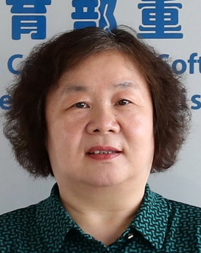

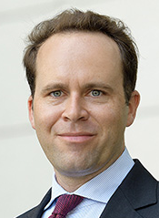
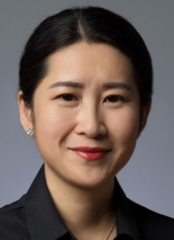
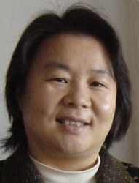
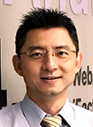
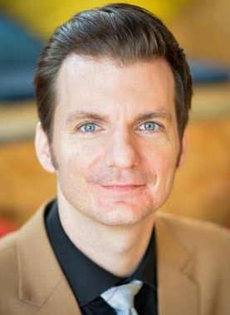
JURY
CHINA ROUND
JAMIE LIN
ADVANTECH
GEORG STIELER
STM
LORA XIE
RINGIER
PROF. XIANGQUN CHEN
BEIJING UNIVERSITY
MICHAEL HACKL
INFOTEAM
TIMO SCHNEEMANN
ROI

Slide 5

Scoring reference
INFRASTRUCTURE
Ability to real-time monitor and control utilities consumption (power, gas, water, waste)
ENTERPRISE CONNECTION
Ability to provide accurate data about operations performance
NETWORK & IT SYSTEM
Ability to handle high degree of configurability & provide relevant real-time data
SUPPLIER CONNECTION
Ability to digitally connect with suppliers to avoid supply chain interruptions
INDUSTRY 4.0
CUSTOMER CONNECTION
Ability to collect data about use to feed back to operations
IN
CAPABILITY
OUT
FRAMEWORK
EQUIPMENT
Ability to listen in on equipment status to increase uptime & longevity
YOUR MATERIAL FLOW
Ability to monitor material flow in real-time to ensure smooth flow
PEOPLE-SYSTEM INTERACTION Ability to augment operations to increase productivity
YOUR SIMULATIONS/AI/ML
Ability to simulate the physical world to generate insight

Slide 6
Scoring reference

Slide 7
Capability levels
CHINA ROUND
AUTONOMY
The system runs without intervention within operating range
PREDICTION
It is possible to make predictions
KNOWLEDGE
Data is automatically consolidated to generate insight
INFORMATION
Data is easily accessible for the people who need it
CONNECTIVITY
Relevant machine & process data is collected
LEAN PROCESS DESIGN
Value. Challenge. Right first time. Flow. Takt. Pull.

Slide 8
2018
26
6
Jury evaluation

Slide 9
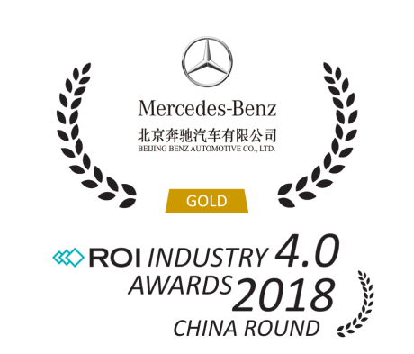
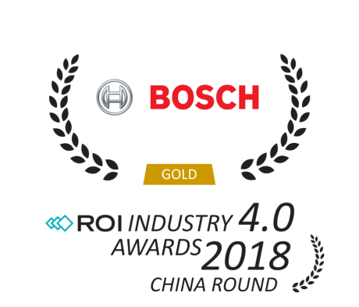
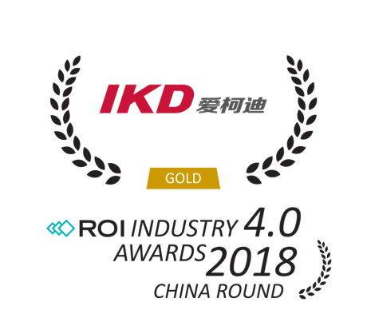
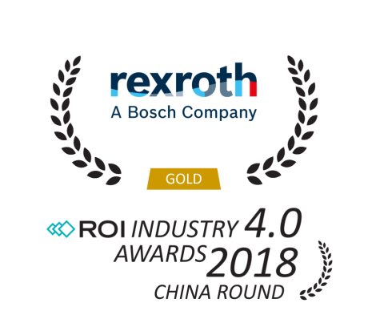
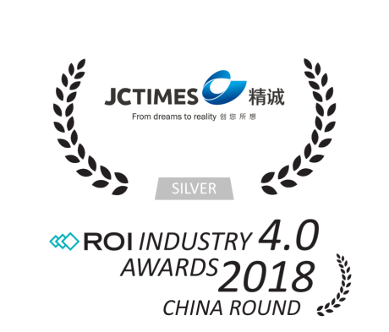

CHAMPIONS OF 2018
SMART FACTORY
CATEGORY BEST MAINTENANCE
SMART FACTORY
CATEGORY BEST
USE OF DATA
SMART FACTORY
CATEGORY BEST
DATA ACCESSIBILITY
SMART FACTORY
CATEGORY BEST
ENERGY MANAGEMENT
SMART FACTORY
CATEGORY IT SYSTEM INTEGRATION
SMART FACTORY
CATEGORY INTELLIGENT AUTOMATION

Slide 10

Innovation & development of iTPM
to increase uptime

Slide 11

Predictive analytics
to improve
tool utilization

Slide 12

Real-time information
at point of use to empower system operation

Slide 13
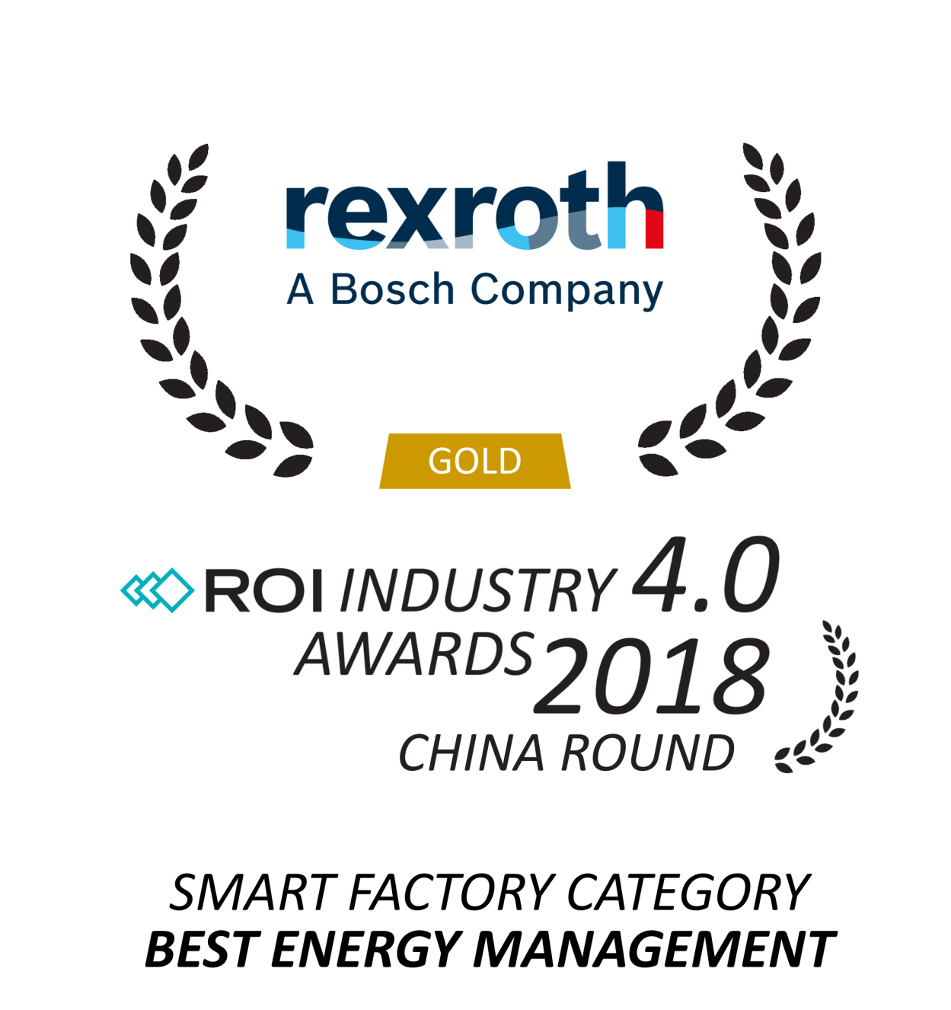
Real-time utility monitoring to optimize resource utilization

Slide 14

Vertical integration
to provide order information in real-time

Slide 15
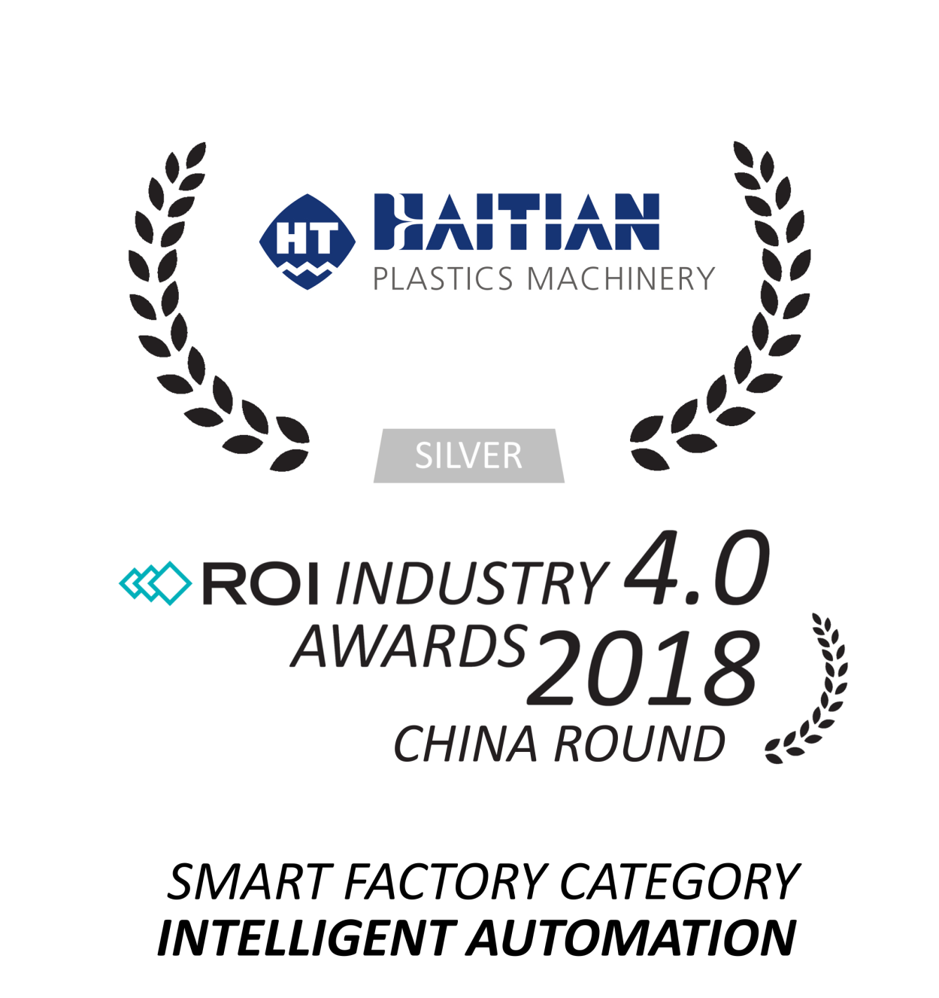
Automated manifold production for high productivity

