Slide 1
CHECKLIST FOR THIS TRAINING BEFORE WE START THIS SESSION:
For all trainings, did you have the following things with you:
Do you have a pen or pencil with you?
Do you have a Notebook or paper (collecting information) with you?
Do you have the relevant information available for this training with you?
Did you Switch off your mobile Phone?
If not completed please organize it right now!!!

Slide 2
CHECKLIST FOR THIS TRAINING BEFORE WE START THIS SESSION:
For all trainings, did you have the following things with you:
Do you have a pen or pencil with you?
Do you have a Notebook or paper (collecting information) with you?
Do you have the relevant information available for this training with you?
Did you Switch off your mobile Phone?
If not completed please organize it right now!!!
✓
✓
✓
✓

Slide 3
Group 1-Axel
GERMAN CHAMBER– Meeting – 20th November 2018
MAINFOCUS: LEAN LEADERSHIP TRAINING CONCEPT Version: 1
Timetable |  | Content | Location | Speaker | Participant
until | 8:45 | Traveling to testo Shenzhen
9:00 | 9:15 | Welcome and introduction of Testo | Room 5-big | Axel | German Chamber
9:15 | 9:30 | Lean & Lean Leaders | Room 5-big | Axel | GC
9:30 | 9:45 | Action Management System – how to manage your trusted system | 6th floor | Philipp | GC
9:45 | 10:00 | Create Vision and align the company goals | 5th floor | Emia | GC
10:00 | 10:15 | Support Daily Kaizen | 4th floor | Ringo | GC
10:15 | 10:30 | Learning to Coach and develop others | 4th floor | Jimmy | GC
10:45 | 11:00 | Commit to Self Development | 3th floor | Rosa | GC
11:00 | 11:15 | Standards, Standard Work and Visual Management | 2th floor | Jim | GC
11:15 | 11:30 | Problem Solving, Improvement & A3 Thinking | 1th floor | Andy | GC
11:30 | 11:45 | Open Question & Lunch later | 5th floor | Axel | GC

Slide 4
Group 2-Quan
GERMAN CHAMBER– Meeting – 20th November 2018
MAINFOCUS: LEAN LEADERSHIP TRAINING CONCEPT Version: 1
Timetable |  | Content | Location | Speaker | Participant
until | 8:45 | Traveling to testo Shenzhen
9:00 | 9:15 | Welcome and introduction of Testo | Room 5-big | Axel | German Chamber
9:15 | 9:30 | Lean & Lean Leaders | Room 5-big | Axel | GC
9:30 | 9:45 | Problem Solving, Improvement & A3 Thinking | 1th floor | Andy | GC
9:45 | 10:00 | Standards, Standard Work and Visual Management | 2th floor | Jim | GC
10:00 | 10:15 | Commit to Self Development | 3th floor | Rosa | GC
10:30 | 10:45 | Learning to Coach and develop others | 4th floor | Jimmy | GC
10:45 | 11:00 | Support Daily Kaizen | 4th floor | Ringo | GC
11:00 | 11:15 | Create Vision and align the company goals | 5th floor | Emia | GC
11:15 | 11:30 | Action Management System – how to manage your trusted system | 6th floor | Philipp | GC
11:30 | 11:45 | Open Question & Lunch later | 5th floor | Axel | GC

Slide 5
Management training: Lean Leadership 2018 Session 1: Lean & Lean Leaders Axel Strittmatter 20th November 2018 Version: 9

Slide 6
PURPOSE WHY WE HAVE THIS TRAINING
All Employees which facing challenging or problem during their daily work at testo Shenzhen should get a common toolbox to execute the following GOAL:
GO & SEE… MY “daily KAIZEN” – what is the next action to reach SUCCESSFUL my DESIRED outcome so that testo Shenzhen reach their COMPANY GOAL’s

Slide 7
Training Session:
Chapter | Topic | host
1 | Lean & Lean Leaders | Axel
2 | Problem Solving, Improvement & A3 Thinking | Andy
3 | Standards, Standard Work and Visual Management | Jim
4 | Commit to Self Development | Rosa
5 | Learning to Coach and develop others | Jimmy
6 | Support Daily Kaizen | Ringo
7 | Create Vision and Align the company goals | Emia
8 | Action Management system – how to manage your trusted system | Philipp
Notes:
21.11.2018
Entwurf Firmenpräsentation

Slide 8
Why we
need a
lean leader ?

Slide 9
選或 不選TSZ是客戶的權利 Our Customer has a choice to select our service
National
Competitor
End-user / Dealer / testo AG
International
Competitor
Notes:
21.11.2018
Entwurf Firmenpräsentation

Slide 10
How we can
satisfied our
Customer ?

Slide 11
如何讓客戶滿意? How we can satisfied our customer?
設計－合適的功能
(數量和品質)
Right features - design (quantity and quality)
產品和服務品質
Product & Service Quality
市場價格 Market price
(材料+人力+結構成本) (Material Price + Labor cost + Structure cost)
交貨期 Lead-time (下單－收貨from customer order to arriving destination)
起訂量 Minimum Order Quantity
Notes:
21.11.2018
Entwurf Firmenpräsentation

Slide 12
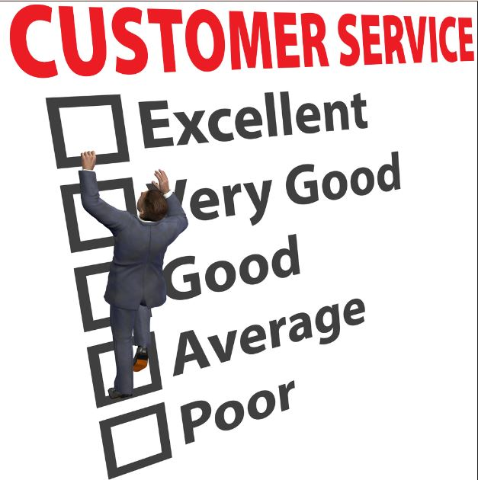
目標：優等服務+合理價格+優良品質。 Our Target is providing a EXCELLENT Service to a reasonable price and good Quality
每年減價1,5 %
Every year -1,5% sales price
reduction
每年每個部門提升效益 6 %
Every year 6% more efficient in
each department
Notes:
21.11.2018
Entwurf Firmenpräsentation

Slide 13
Continues Improvement

Slide 14
TRUE
NORTH

Slide 15
Process landscape
target - value

Slide 16
company goal
To continue our prosperity and achieve a greater success in the future, the main goal of Testo Shenzhen is:
right time/ price
Zero failure
right specification/quantities

Slide 17
MISSION of testo Shenzhen – true north
we provide world-class portable measurement instruments and services to meet your customers’ needs
Food & Drugs
HVAC/R
continues improvement
COMPETENCE
MENTORING
service priority
process priority
Right from me
do the right things
1. quality (Q)
2. time to market (T)
3. product/service cost (C)
do the things right
1. safety/ Environment (S)
2. quality (Q)
3. delivery (T)
4. cost (C)
demand-driven
output
standardized working method (eliminating waste)
modular-
ization
visualization
creativity
cross functional
&
parallel work
problem
solving stories
focus
customer first
respect for the
individual
quality -
do the right things
right (zero-failure)

Slide 18
Process landscape
Clear process how to reach the target
Multiple targets in the same year

Slide 19
way of lead leadership mentoring YOUR employees

Slide 20
Lean Philosophy in testo Shenzhen
Managing Director
Strategic Consultant Service Area
Process Coach
Employee
Employee
Department Head B
Employee
Employee
Employee
Employee
Department Head A
Process Coach
Department Head D
Department Head C
Employee
Employee
Employee
Employee
Employee
Process Coach
Employee
Employee
Team Leader C1
Employee
Employee
Team Leader C2
Employee
Employee
Understand the benefit
Support Lean Idea
neutral
Support Lean Idea
motivated
motivated
neutral

Slide 21
Lean Philosophy in testo Shenzhen
Managing Director
Strategic Consultant Service Area
Process Coach
Employee
Employee
Department Head B
Employee
Employee
Employee
Employee
Department Head A
Process Coach
Department Head D
Department Head C
Employee
Employee
Employee
Employee
Employee
Process Coach
Employee
Employee
Team Leader C1
Employee
Employee
Team Leader C2
Employee
Employee
Understand the benefit
Support Lean Idea
neutral
Support Lean Idea
motivated
motivated
department
neutral

Slide 22
Lean Philosophy in testo Shenzhen
Managing Director
Strategic Consultant Service Area
Process Coach
Employee
Employee
Department Head B
Employee
Employee
Employee
Employee
Department Head A
Process Coach
Department Head D
Department Head C
Employee
Employee
Employee
Employee
Employee
Process Coach
Employee
Employee
Team Leader C1
Employee
Employee
Team Leader C2
Employee
Employee
Understand the benefit
Support Lean Idea
neutral
Support Lean Idea
motivated
motivated
process
neutral

Slide 23
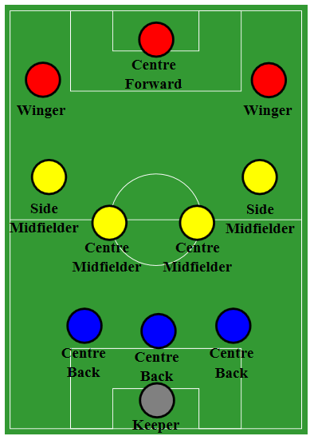
Similarity of a soccer Team
one
team
&
one
strategy
Doctor
Manager
Trainer

Slide 24
Similarity of a soccer Team
Engineering
Service
one
team
&
one
strategy
TSZ-Management
Manufacturing
Service
Doctor
Manager
Trainer
Supporting
Service

Slide 25
Lean System

Slide 26
Old dictator style

Slide 27
Empowerment style

Slide 28
Lean Manager style

Slide 29
Lean Leadership - overview

Slide 30
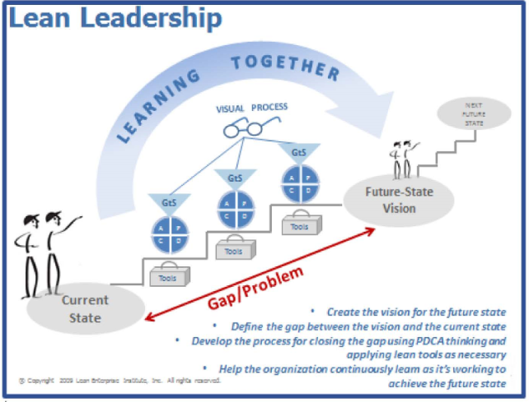
Lean Leadership mentoring system - overview
Testo Master Mentor
Mentor Training: Master training
+ five Mentee finished under your mentoring
5 x A3 Project under your mentoring successful
Testo Senior Mentor
Testo Senior Mentor Training: Advanced Training
+ two Mentee finished under your mentoring
2 x A3 Projects under your mentoring successful
Testo Mentor
Testo Mentor Training:
Lean Leadership (based on the book)
+ one own A3 Successful carry out
we are here
Testo Mentee

Slide 31
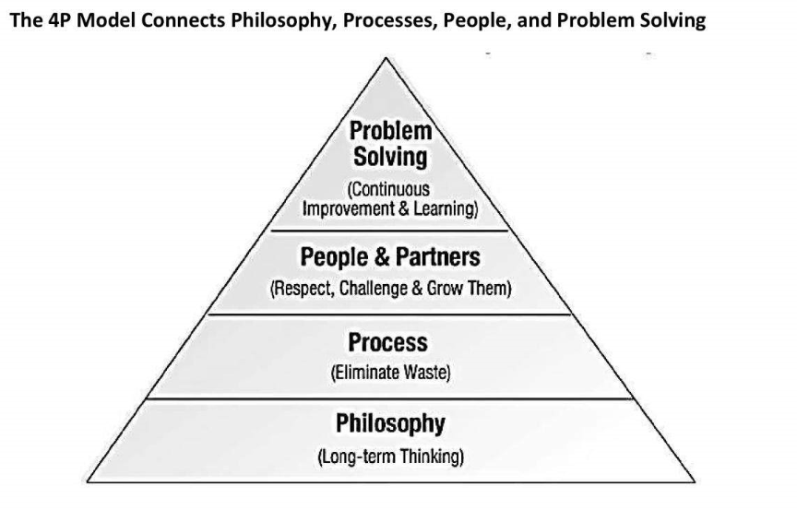
The 4P Model connects Philosophy, Processes, People and problem Solving

Slide 32
Vertical versus Horizontal Organization

Slide 33
Disconnected processes and inventory hide problems

Slide 34
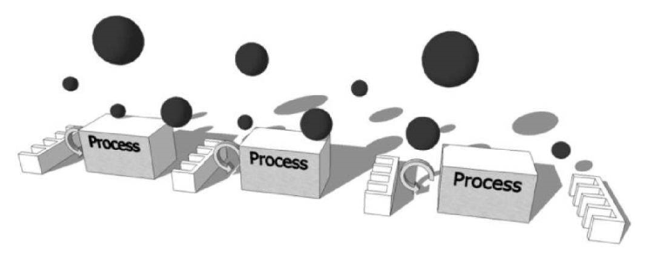
Process connected together surface problems
INPUT :
PROCESS REVIEW BOARDS AUDITS

Slide 35
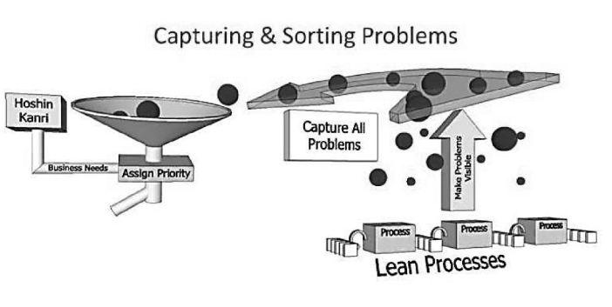
Capturing, Sorting Problems and Assigning Priority
SUPPORT FROM
PRB- GEMBA WALK &
STRATEGIC CONSULTANTS

Slide 36
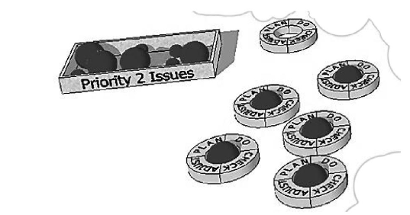
Priority 1 (PDCA) issues and priority 2 issues
SUPPORT FROM
Service Area – Weekly Meeting HOD
STRATEGIC CONSULTANTS

Slide 37
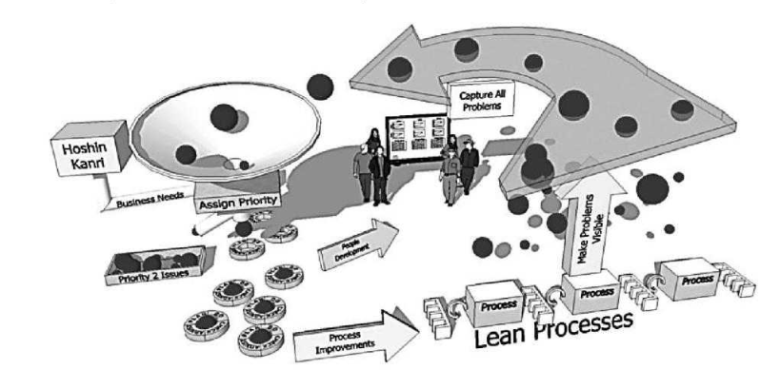
The complete Lean System
SUPPORT FROM
Service Area – Weekly Meeting HOD
STRATEGIC CONSULTANTS

Slide 38
SKILLS
of a
LEAN LEADER

Slide 39
What is the requested skills of a lean leader?

Slide 40
10 skills of a lean leader
1. Working with Passion
2. Communicating openly and often
3. Creating a sense of urgency
4. Focusing on the Future, not the past
5. Developing good leaders for the future
6. Focusing on your customers
7. Measuring your success
8. Maintain discipline and focus
9. Walk the talk
10. Promoting Continuous Improvement daily
http://kaizentrainer.co.uk/

Slide 41
What is the purpose of this event today ?

Slide 42
What is the purpose of this event today?
Encourage other companies to run a similar event to share the good parctise and the failure you learnd out of it.
SHOW (make visible) the benefit (output) of the topic today (LEAN LEADERSHIP).
Have Lean Leaders they drive independent and according companys interest the relevant topic forward.

Slide 43
First event organized for GGC in this building in 2014 by me: SHOP FLOOR MANAGEMENT
# | Description | Owner | Total Effort | remark
1 | Concept of the workshop | Axel | 4h | AS - 1h
2 | Preparation | Axel | 4h | AS - 1h
3 | Gemba Walk | Axel | 2h | AS - 2h
4 | Organize Meeting | Axel | 1h | AS - 1h
5 | Prepare different workstation | Axel | 6h | AS - 2h
6 | Prepare hand outs and details | Axel | 2h | AS - 1h
… | Ect…. |  | Total: 19h
# | EVALUATION | measures
1 | EFFORT SPEND BY ME: | 8h
2 | QUALITY OF THE EVENT my own feeling: | 95%
3 | LEARNING FOR THE OTHER trainers: | 20%

Slide 44
First event organized for GGC in this building in 2014 by me: SHOP FLOOR MANAGEMENT
# | Description | Owner | Total Effort | remark
1 | Concept of the workshop | Axel -> Rosa | 1h | AS 10 min
2 | Preparation | Rosa | .5h
3 | Gemba Walk | Axel | 1h | AS 40 min
4 | Organize Meeting | Rosa | 2h
5 | Prepare different workstation | trainers | 4h | AS 30 min
6 | Prepare hand outs and details | trainers | 1h
… | Ect…. |  | Total: 9.5h
# | EVALUATION | measures
1 | EFFORT SPEND BY ME: | 1,5h
2 | QUALITY OF THE EVENT my own feeling: | 80%
3 | LEARNING FOR THE OTHER trainers: | 60%

Slide 45
Comparison of both ways….
Old dictator style:
# | EVALUATION | measures
1 | EFFORT SPEND BY ME: | 8h
2 | QUALITY OF THE EVENT my own feeling: | 95%
3 | LEARNING FOR THE OTHER trainers: | 20%
Lean Manager style:
# | EVALUATION | measures
1 | EFFORT SPEND BY ME: | 1,5h
2 | QUALITY OF THE EVENT my own feeling: | 80%
3 | LEARNING FOR THE OTHER trainers: | 60%

Slide 46
BOOKS WE USE FOR OUT TRAINING….

Slide 47
TRAINING STYLE (3hour session – 9-12am)
Use a book chapter as to read or audio for per study (40% of the test content)
preparation
Present topic of today training.
Ask question
Work as a group
Check what the students understood with a test
(max 100% of the test paper result)
PPT and book (60% of the test content)
ADD POINTS if you answer them correct. (max.20% of the total ranking)

