Slide 1
--Standards, Standard Work, and Visual Management
Management training: Lean Leadership

Slide 2
Agenda
1. Standard and Standard Work 2. Standard and continuous Improvement 3. Visual Management 4. Activities 5. Questioner

Slide 3
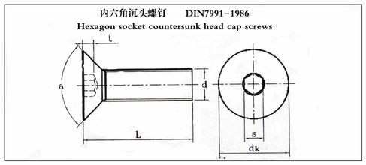
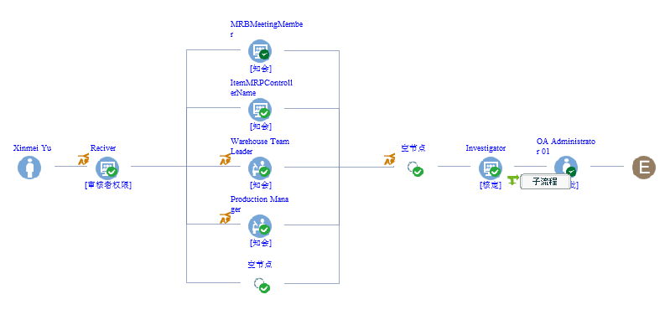
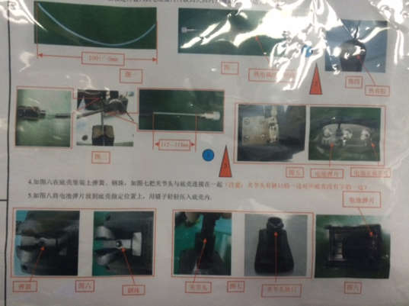
1. Standard, Standard Work

Slide 4
1. Standard, Standard Work
For Standard Work in Repetitive Tasks or Process:
We can specify in a lot of detail the steps, the sequence, the time that it should take and the key points.
For Standard Document for non-cyclical Work:
There may be certain aspects of the non-repeating tasks that are highly routine we can create standard work sheets for those parts.
For non-routine parts, we can still identify the necessary steps and key points.

Slide 5
1. Standard, Standard Work
Coercive Bureaucracy:
Assumption that people who came up with standard sitting in their office know better than the people who are doing the work
Everyone is expected to follow the standard exactly, and deviations are punished
Rigid rules created and enforced by staff people who do not understand the work or how to engage the team member
Enabling Bureaucracy:
Assumption that people doing the work, and people leading those doing the work, have the most detailed Understanding of work
When there is a deviation from the standard, they are at gemba to find the root cause
Why did this deviation occur? Find the root cause.

Slide 6
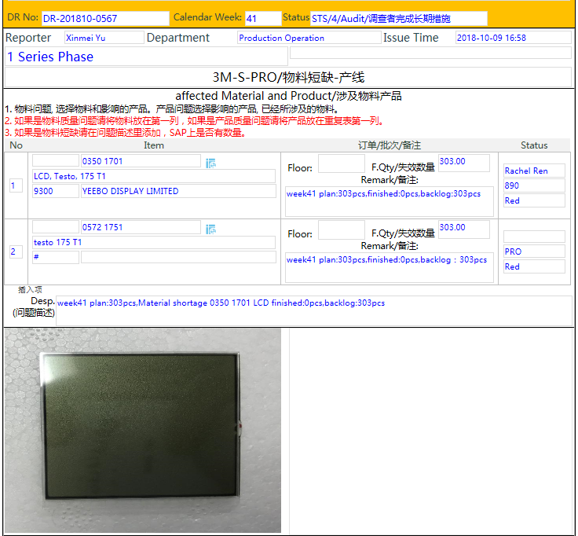
1. Standard, Standard Work
standard Worksheet: List of Steps within a cycle for that particular task
The best way in this sequence
Subdivide these steps into more microscopic sub-steps
Standard work document: show the key points in no particular steps
Do all these steps correctly or check all these items
Act like airplane pilot’s checklist or box “does not apply”

Slide 7
What does a Standard do?
Basis for (Job) Training
Maintains existing Know-How
Ensures stability in processes and work flows
Eases repetitive / recurring work
Prevents errors from recurring
Basis for audit or error diagnosis
... To be able to do something in the best,
simplest and safest way.

Slide 8
How should a Standard look like?
simple
feasible
safe
clear
sensible

Slide 9
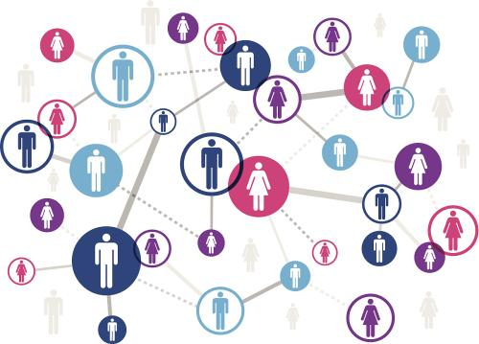
Digitalization
Office Automation

Slide 10
2. Standard and continuous Improvement

Slide 11
2. Standard and continuous Improvement
True North is our Ultimate Standard

Slide 12
Standard provide a point of comparison.
In either case ,what we have is an opportunity for improvement
Deviation from Standard could be that someone is not well trained, that the equipment does not work right. There many other possible cause.
Deviation could be a better way.
What is actually happening
What we believe should be happening

Slide 13
2. Standard and continuous Improvement-Develop people
Standard is our theory about the best way to do job. We may not specify every contingency or situation, but we know some basic things that everybody in that job should do, that might be useful for others.
Everybody follows that theory. That allows us collectively to improve the process.
so we can test our standard. We are getting better at spotting Deviation. We are getting better at improving on the standard work

Slide 14
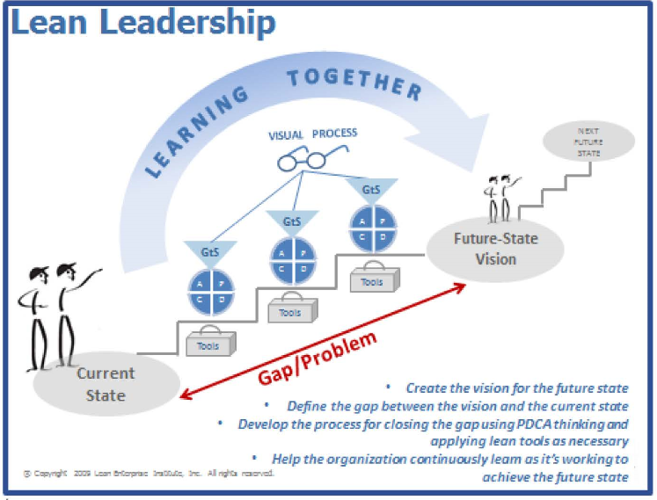
2. Standard and continuous Improvement-Lean Leadership
Leadership at the gemba to maintain discipline to the standards and led improvement of the standards.

Slide 15
2. Standard and continuous Improvement-Lean’s Core Leadership Model
Visualize production
To reveal problems and react quickly
And solve them one by one
To increase the standard and challenge

Slide 16
Lean System

Slide 17
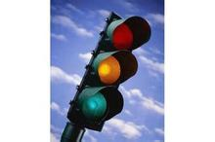
Visual Management to See the Gaps: Standard vs Actual
Visual Management builds on standard work, standards, standard processes, targets, target conditions
Visual management help you to guide your work and clearly show what you should doing now and gap

Slide 18
Visual Management Support a Collaborative Culture
This becomes a collaborative process in which it is clear to all team members and leaders what is in standard, what is out of standard and where we are:
“Visual Management is
about seeing together,
so we know together,
so we know together,
so we can act together, from the operator to the CEO”

Slide 19
END
Thanks for your attention

