Slide 1
Management training: Lean Leadership 2016 Session 5: Learning to Coach and develop others Jimmy Yeung 23rd October 2018 Version: 3

Slide 2
Training Session:
Chapter 0 | Topic | host
1 | Lean & Lean Leaders | Axel
2 | Problem Solving, Improvement & A3 Thinking | Andy
3 | Standards, Standard Work and Visual Management | Jim
4 | Commit to Self Development | Rosa
5 | Learning to Coach and develop others | Jimmy
6 | Support Daily Kaizen | Ringo
7 | Create Vision and Align goals through hoshin kanri | Emia
8 | Connecting Strategy to Operational Excellence | Philipp
Notes:
21.11.2018
Entwurf Firmenpräsentation

Slide 3
Time Schedule of today
Start | End | Topic
10:00 | 10:40 | Effective coaching and developing
10:40 | 10:50 | break
10:50 | 11:40 | Coaching Kata
11:40 | 11:50 | Tests
Notes:
21.11.2018
Entwurf Firmenpräsentation

Slide 5
1. Effective Coaching and developing
Why we need to coach and develop?

Slide 6
1. Effective Coaching and developing

Slide 7
1. Effective Coaching and developing 教練基本素質
Skills needed for OJD ( on the job development):
1. See the true potential
2. Teach at right level for each student
3. Gauge where the students are in their maturity, problem solving capability, interpersonal skill and attitude

Slide 8
1. Effective Coaching and developing
Key to lean leadership is developing others at the Gemba !
On Site ( 现场 )

Slide 9
1. Effective coaching – 6 steps to being an effective coach
1. Assess others their current understanding and skill ( 因材施教)
2. Develop in others Disciplined Problem solving (扎稳基础 )
3. Break down Task & Give Assignments to increase skill level ( 实践中学习)
4. Teach by Questioning instead of telling (引导思考)
5. Build trusting relationships with your students ( 彼此信 任)
6. Balance Praise with Critical feedback (谆谆善诱)

Slide 10
break
Break for
5 minutes

Slide 11
2. Coaching Kata (教练基本招式)
Kata are structured routines that you practice deliberately, especially at the beginning, so their pattern becomes a habit and leaves you with new abilities. Kata are a way of learning fundamental skills that you can build on. The word comes from the martial arts, where Kata are used to train combatants in fundamental moves. But the idea of a Kata can be applied in a much broader sense. The Improvement Kata and Coaching Kata are for training managers and leaders in a new way of doing their jobs.
Kata = 形
( form , type)

Slide 12
2. Using Coaching Kata to teach the Improvement Kata

Slide 13
2. Coaching Kata and Improvement Kata interacting ( CK vs IK 互動)

Slide 14
. 2. Coaching Kata and Improvement Kata

Slide 15
.2. Coaching Kata and Improvement Kata

Slide 16
. 2. Coaching Kata and Improvement Kata

Slide 17
. 2. Coaching Kata and Improvement Kata interacting

Slide 18
. 2. Coaching Kata and Improvement Kata

Slide 19
2. Coaching Kata and Improvement Kata

Slide 20
2. Coaching Kata and Improvement Kata interacting ( CK vs IK 互動)

Slide 21
3. Summary:
Three-Part recipe for Lean leaders Must learn
1. Live the 5 core values of the philosophy – Toyota way 2001
1.1 Challenge
1.2 Go to the Gemba and see
1.3 develop a kaizen mind
1.4 respect
1.5 team work

Slide 22
3. Summary:
Three-Part recipe for Lean leaders Must learn
Live the 5 core values of the philosophy
- Toyota way 2001
Become a role model for disciplined problem solving
- Toyota Business Practice ( Improvement Kata )
Become a teacher and coach for disciplined problem solving
- OJD ( On the Job Development ) (coaching Kata )

Slide 23
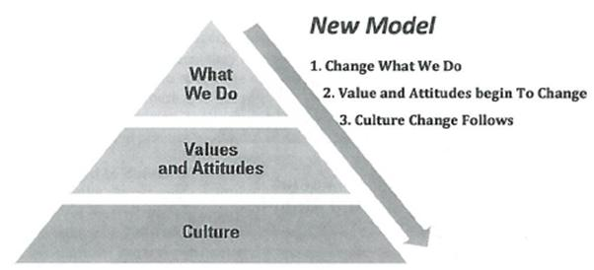
3. Summary: Change Culture through Changing Behavior
If we want to get to culture, start with what we do!
做出文化来 !

Slide 24
Q&A
Q & A

Slide 25
end
Thank you!

