Slide 1
Management training: Lean Leadership 2018 Create Vision & align goals through Hoshin Kanri Emia Hu 15th November 2018 Version: 2

Slide 2
Lean Leadership Development Model
Notes:
The guiding principle for developing yourself as a lean leader are the true north values
To come to the true north values, repeating PDCA‘s are necessary.

Slide 4
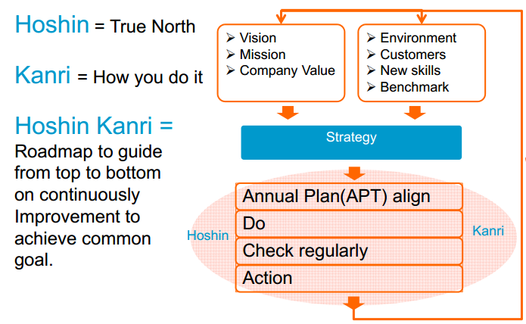

Slide 10
Way 1

Slide 11
Way 2

Slide 12
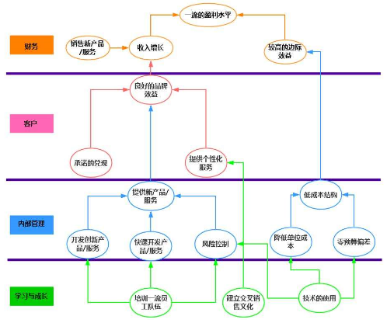
Way 3
BSC

Slide 13
Group Discussion

Slide 14
Pratice: Plan for each level’s Hoshin

Slide 16
End

