Slide 1
Management training: Lean Leadership 2018 Session 4: Commit to Self Development Rosa Wu

Slide 2
Lean Leadership Development Model
Notes:
The guiding principle for developing yourself as a lean leader are the true north values
To come to the true north values, repeating PDCA‘s are necessary.

Slide 3
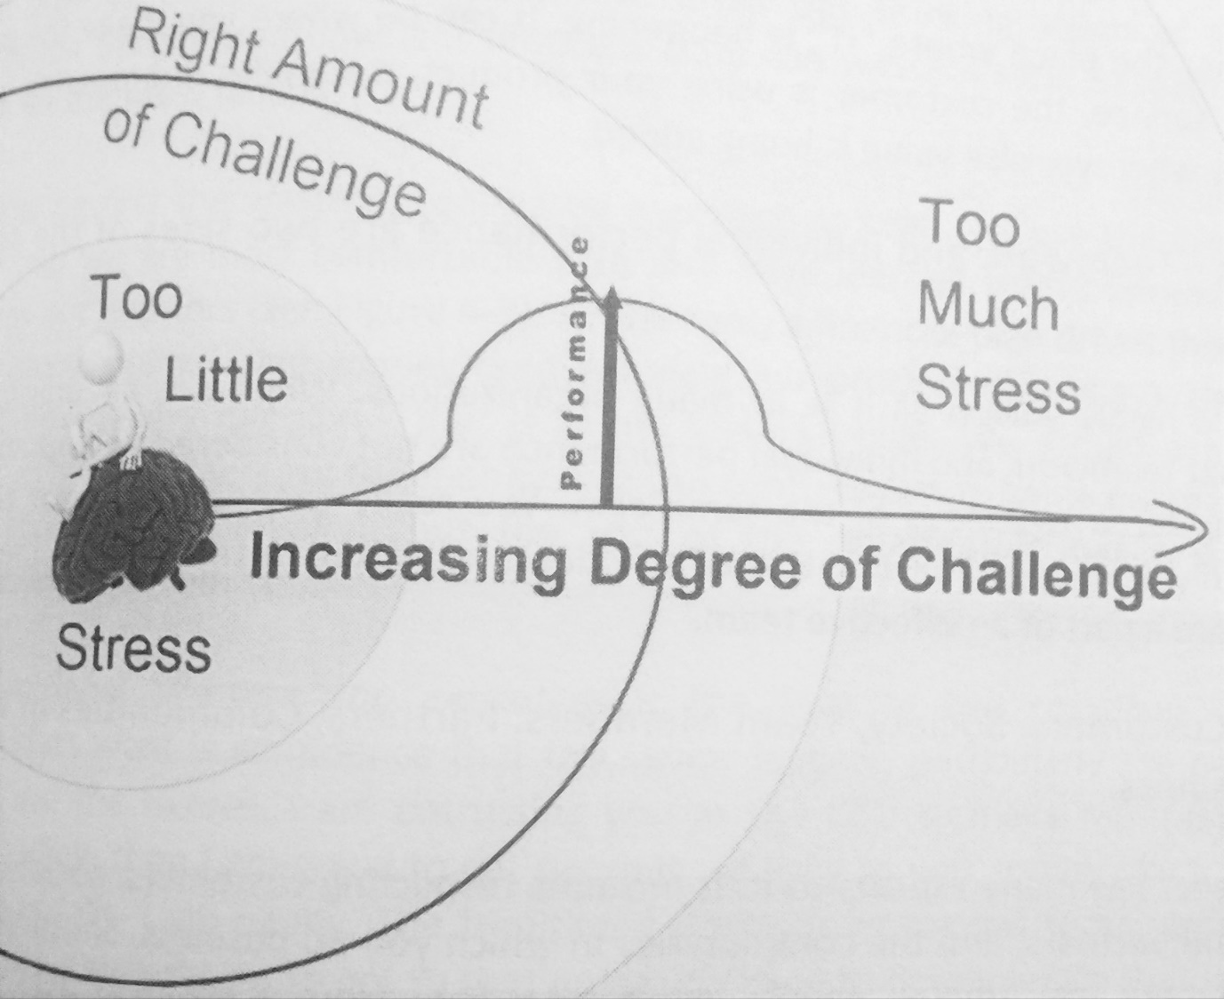
True North Values 1: Challenge
Right amount of challenge
The Goldilocks Principle of Stress
Notes:
Challenges help to adapte and grow stronger
Without challenge there is no pressure to improve
To less stress will lead that the people stagnate → decrease the performance and learning
To much stress will have the same effect then to less stress. The people stagnete

Slide 4
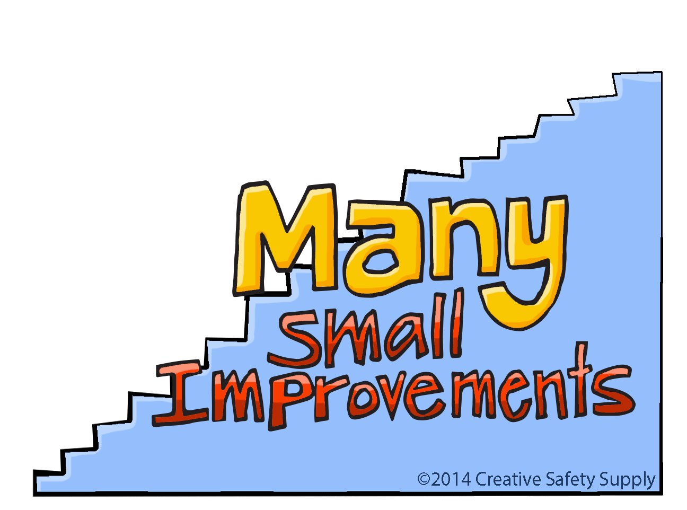
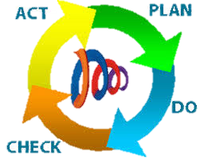
True North Values 2: Kaizen Mind
True
North

Slide 5
True North Values 3: Go and See (Gemba)
Quoted by: Taiichi Ohno
Notes:
Example of the cable driller.
Germany requested us to pack 3m cable as a bundle of ten pieces.
We discussed in the meeting room for around 30 minutes how to do.
We saw many problems, how to carry this cable from one station to annother station in our one piece flow line, had a lot of ideas.
However, after 30 minutes i said, lets stop here, i give you a update next week.
In the end, the topic was solved withhin 5 minutes discussion with the produciton personal.

Slide 6
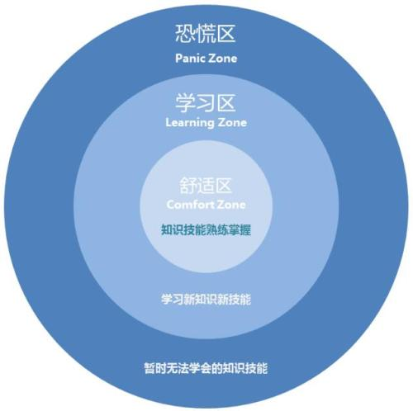
True North Values 1: Challenge
Learning Zone
Notes:
Challenges help to adapte and grow stronger
Without challenge there is no pressure to improve
To less stress will lead that the people stagnate → decrease the performance and learning
To much stress will have the same effect then to less stress. The people stagnete

Slide 7
Leadership Self-Development Learning cylce (PDCA)
Select for a new challenge for new possibilities to learn
Self assess skills and identify strength and weaknesses.
Go gemba and make a picture of current status
Prepare
Do
Check
Advance
Reflect and learn out of the mistakes. Be a coach
Develop others and achieve challenging goals. Make experiments to learn and get out of the comfort zone.

Slide 8
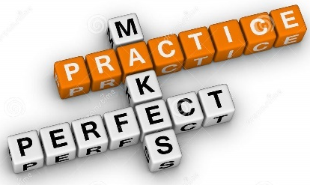
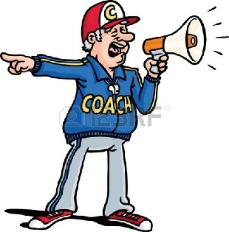
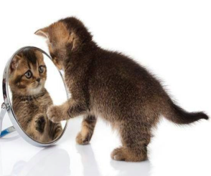
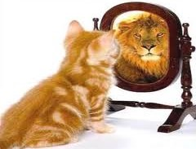
The Challenge of Self-development
Deep Commitment
A coach
Practice, practice and practice

