Slide 1
Lean Leadership - overview
Problem Solving your way toward an ideal state

Slide 2
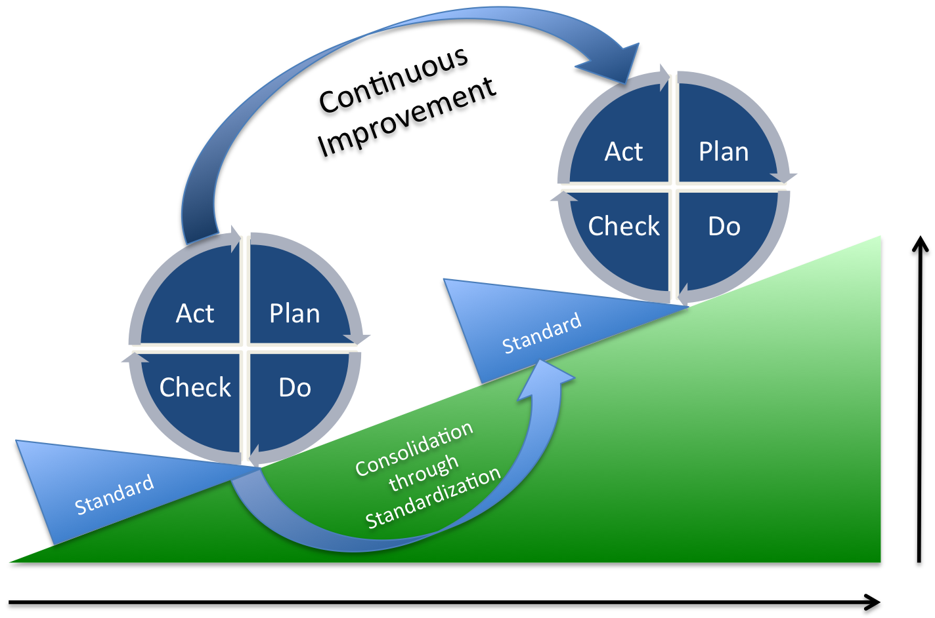
Features of PDCA cycle PDCA循环的特点
P-D-C-A linked like a cycle to scroll forward
Achievement from one cycle to another cycle
One big cycle can be break down into small cycles
Consolidation through standardization

Slide 3
How do we solve problem 如何解决问题

Slide 4
PDCA cycle – 8 steps
Problem perceived
Do
6. See Countermeasures Through
1.Clarify the Problem vs
Ideal State
Plan
2. Grasp the Present Situation
And see the Gaps
Check
7. Monitor both Results and
Processes
3. Breakdown Problem and
Set Targets
4. Analyze Underlying Causes
Act
5. Develop Countermeasures
8. Standardize and Spread
Notes:
What do we want from PDCA Report?
A clear statement of the problem 清晰的问题的陈述
A clear presentation of facts, not feelings 对事实而非感觉的陈述
An objective analysis of data 对数据的客观分析
A specific, rational conclusion 明确，合理的结论
Clear stated recommended actions 清晰的策略
Short term / Long term solution 短期/长期措施
Monitoring activity / Next step / Follow up 监控进展，后续计划，追踪跟进

Slide 5
Driving to the Root cause though 5 whys
Effect
Problem
Symptom
Key words
Deeply observe
Narrowing the Focus
DO NOT ask Why? At Effect/Symptom stage
POC-Point of Cause (Direct cause
After you identify the POC ask Why
Countermeasures
Initial problem perception
Clarify the problem
The real problem
Grasp the situation:
when, who, where, which, what
Point of cause
Cause investigation:
Why?→
Why?→
Why?→
Why?→
Why?→
POC
Cause
Cause
Cause
Root cause

Slide 6
Identify “WHY” by using Fishbone Diagram
Fish bone Diagram （Cause & Effect）鱼骨图 (因果分析)
Used identify possible caused of problem 说明变数之间的关系
Focus on caused, not symptoms 重点在”病因”，而非”病症”
Man人
Method
法
EFFECT
问题
Environment环
Machine
机
Material
物

Slide 7
Four types of A3 Stories

Slide 8
A3 report with PDCA thinking

Slide 9
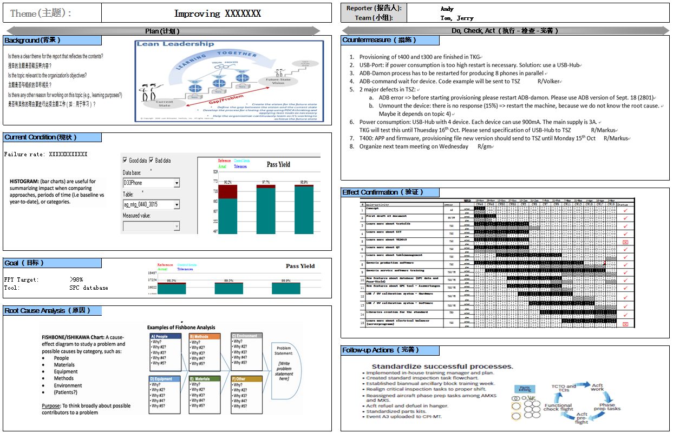
What is the “A3”

