Slide 1
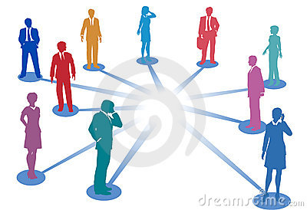
Identifying Your Social Brain
Neural pathways to connection
Presented by
Dr. Reza Samvat &
Dr. Arini Verwer

Slide 2
Understanding Your Social Brain
Identifying Your Social Brain
Value of knowing your Social Brain:
You will understand how:
People processes information and what information is important to them
How to connect to others using their social brain mode
How to appreciate and leverage their talents
How to motivate and bring out their best
How to work with their learning style
Build teams and create work harmony

Slide 3
iHEART Protocol Workshop-
“The role of social brain in developing values "
Tools to develop personal, interpersonal and societal based capabilities as a leader, based on the neurosciences.
Identification of your Social Brain Mode
Strengthening qualities at the physical level (Personal)
Strengthening qualities at the emotional level (Personal)
Strengthening qualities at the relational level (Interpersonal)
Strengthening qualities at the Leadership level (Societal)
Using your learning style to accelerate development of strategic leadership capabilities
How to monitor and reward progress

Slide 4
How we Journey through life and these levels of consciousness is based on how We make sense of the world and interpret the Rhythm of life
4- Love .Unity, Service
3- Learning /Reasoning , Ideas, moral decision making
2- Relating/Emotions
1- Movement/Adaptation /Orientation/Safety, survival
“ALL BEHAVIOR IS A REFLECTION OF BRAIN FUNCTION”
(Kendall & Schwartz, Principles of Neural Science, 3rd edition page 1 sentence 1)

Slide 5
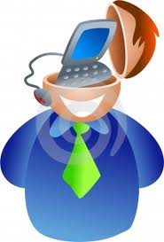
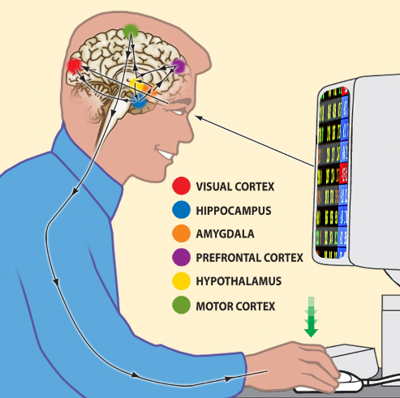
6 TYPES OF HUMAN COMPUTERS
MENTAL
ACTION
RELATIONAL
Action-Relation-Logic/Ideas/Mental
Input
OUTPUT
MISSING
Purple:R-M-A
Blue:M-R-A
Green:M-A-R
Yellow:A-M-R
Orange:R-A-M
Red:A-R-M

Slide 6
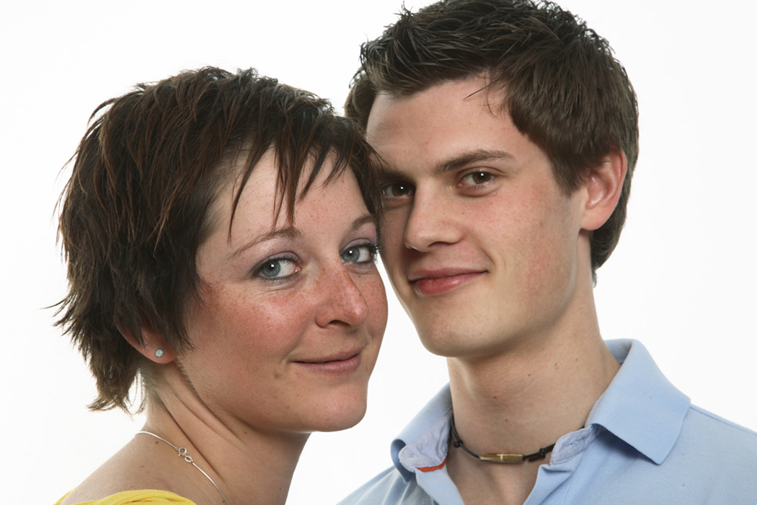

Identifying Your Social Brain
Ways of processing information
While there are three possible domains of processing we are born with only two domains:
how we process- highly developed
what we process- partly developed, and
The third mode is not natural to us
  - We need to learn this domain termed our acquired domain to integrate our social brain

Slide 7
Understand your Communication Code
Understanding People
Identifying Your Social Brain
Work towards integration
Great Relationships
Ways of processing information
How do these processes work together?
Acquired
How we process
What we process
Integration

Slide 8
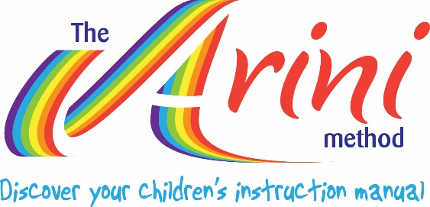
Work towards integration
Understand your Communication Code
Understanding Children’s Behaviour
Identifying Your Social Brain
Understanding People
Three systems of processing information
Great Relationships
Ways of processing information
How do these processes work together?
Physical being: Associative Memory- reflexes
Hand movements backwards and forwards
Mental being: Nervous System
Hand movements up and down
Relational Being: Shimmer across brain
Hand movements from side to side
Acquired
How we process
What we process
Integration

Slide 9
Three domains of how people solve problems and situations, one dominant, active in each of us, but to a different degree
Identifying Your Social Brain
Mind | Relational | Action
Thinking Objectivity Vision Overview Structure Values | Feeling Subjectivity Relations Communication Organization Visualisation | Making Doing Realizing Sensory Awareness Practical Systems view

Slide 10


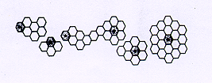
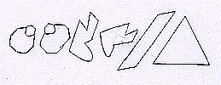

Rhythm of Communication
Internal Processing
Purple – Relational/Mind
Goal Directed
Orange – Relational/Action Connection
Blue – Mind/Relational-Purpose
Yellow – Action/Mind Objective
Green – Mind/Action -Principle
Red –Action/Relational - Facts and data

Slide 11
Communication Code | Strengths / limitations
Purple – Relational/ Mind | S: Goal directed, translate ideas into reality, visionary, entrepreneurial L: Not realistic about time takes to develop an idea, not present in body. Miss the action mode
Blue – Mind/ Relational | S: Purposeful, sensitive to developing peoples capacity L: Not present in the here and now and unrealistic about time. Miss the action mode
Green- Mind/ Action | S: Principle driven, translate vision into systems, pragmatic, maintain perspective and objectivity L: Not sensitive to the human factors. Miss the relational mode
Yellow – Action/ Mind | S; Focused on the objective and methodical in completing the task, diligent and thorough. L: Find difficulty in expressing feelings, loose sight of the big picture. Miss the relational mode.
Orange- Relational/ Action | S: Connected to people, things and ideas, present in the moment, expressive and organisers. L: Needs to be more objective, discerning and detached rather than personalising. Miss the mind mode
Red – Action/ Relational | S: Researchers, pragmatic and practical, action oriented, use past as reference point to make decisions. L: Get overwhelmed by too much data and information need to prioritise and be more strategic Miss the mind mode

Slide 12
How the mode influences learning
Understanding People
Identifying Your Social Brain
There are six different modes of interaction with the environment-all unique
Each mode has different strengths and challenges
How do we stimulate each of the different modes?
How do we arrange the environment for each of the modes to learn effectively?

Slide 13
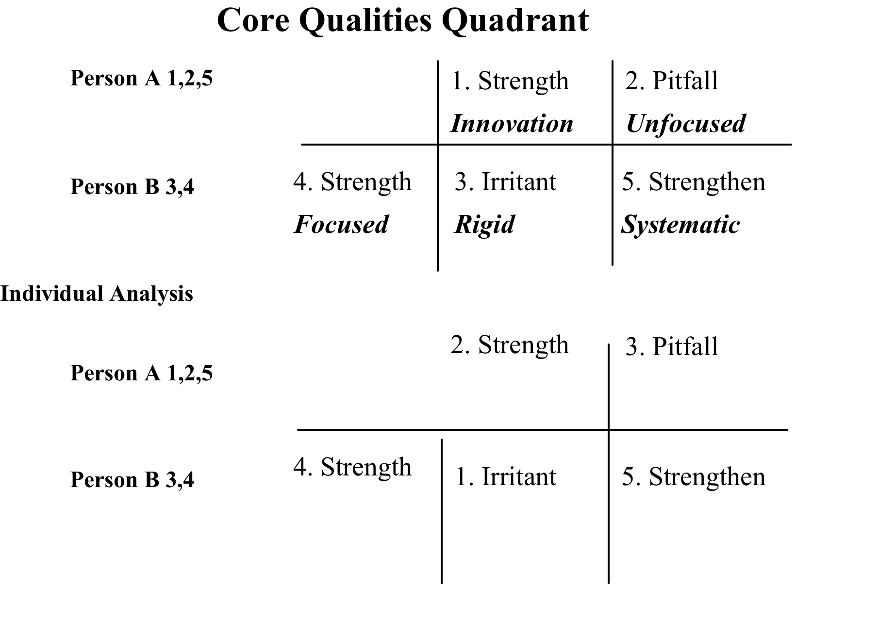
TRANSFORMING FRUSTRATIONS INTO FASCINATIONS

Slide 14
FOUR QUALITY QUADRANT EXPLANATION
An irritant is the opposite characteristic of your strength that you feel annoyed about or criticize in another person.
A strength is a quality of character that we do easily and place a high value on demonstrating this quality.
The downside of a strength, if you do too much of the strength, the strength becomes a pitfall.
The irritant in another person is like the pitfall in you, as it is the downside of another strength. For each pitfall there is a continuum where the upside of that negative quality becomes a strength in another person.
The quality that you need to strengthen in yourself so that you can still retain your strength quality but prevent it becoming a weakness. It acts as a counterbalance to preventing the strength becoming a weakness.

Slide 15
