Slide 1
Platform Introduction

Slide 2
About EventBank
EventBank is the first integrated event-to-revenue SaaS platform. We offer a trusted technology solution to marketing decision makers in organizations of all sizes, ranging from multinational enterprises to professional associations and SMEs.
Align your events and customer relationships using EB Connect.
EB Connect provides an all-in-one social platform that ensures you get the greatest ROI from the events you attend and enables you to maximize your membership benefits from professional organizations you join.

Slide 3
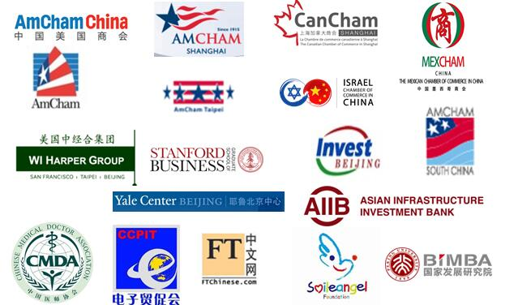
Our Customers (International & Local)
Our values form the cornerstone of EventBank. They guide everything we do, from developing a new feature to responding to your feedback.
Our mission’s success depends on our high ethical standards, and we value our relationships. You can be sure EventBank will protect your information and respect your privacy.

Slide 4
Email Marketing Execute email campaigns that reach the right people with the right message.
01. Subscriptions
Create targeted subscriptions for specialized types of contacts, event attendees, and members.
Using our email subscriptions feature, you can share relevant knowledge, content, and events to different types of members. EventBank organizations create and manage all of their subscriptions.

Slide 5
Email Marketing Create professional newsletters, event invitations, and marketing campaigns.
02. Content customization
Create Email Campaigns that reflect your brand.
EventBank’s email campaigns features allow you to create, schedule, and send emails and newsletters. You can also customize and save email templates.

Slide 6
Email Marketing
03. Email campaign analytics
Optimize email campaigns with our email analytics.
EventBank’s email analytics let see you who has opened, clicked, or ignored your email campaigns and lets you compare the success of different email campaigns.
Successful email campaigns
Subtitle Execute email campaigns that reflect your professional brand and network.

Slide 7
Event Management
From event creation and online registration to mobile check-ins to follow-up emails, EventBank makes each step of the event management process more efficient.
01. Website Publishing
Create Successful event websites that reflect your brand
Events can be easily and professionally created, customized, and viewed on mobile Devices as well as desktops not phones, tablets phones, tablets, and desktops easily.

Slide 8
Event Management
02. Online Registration
EventBank’s registration simplifies registration through a few clicks on the online or mobile devices.
You can customize registration forms to gather all the data you want to collect on event attendees as well as manage your registration list. Using our all-in-one platform you can manage one registration online, accessible by your entire team while tracking attendee registration from your desktop, or mobile device using our EventBank app.

Slide 9
Event Management
03. Event Promotion
EventBank gives you all the tools to market a great event.
You can promote your event on multiple social media platforms and send different event invitations to different types of event attendees. You can track event invitation analytics and see who has clicked and opened their event invitations.

Slide 10
Event Management
04. Mobile Check-In
Eliminate lines with your mobile and online event check-ins
Scan your attendee's e-ticket, search the registration, or add a walk-in attendees while their attendance information is automatically tracked in the system real time. EventBank app is available on Android and iOS. Stay in know where ever you go.

Slide 11
CRM
01.Contact and opportunity management.
Keep organized and put contacts and leads to work.
Manage members, contacts, and leads in our marketing CRM. Customize fields for all your contacts that suit your marketing, events, and sales needs. Import and export any of your contacts lists.

Slide 12
CRM
02. Email and Event Integration
EventBank ensures that all your membership, event, and email campaign data stay centralized.
Each contact profile shows how many events your contacts have registered for and attended as well as how many email campaigns they have opened and clicked.

Slide 13
CRM
03. Smart Lists
Optimize and segment all the data in your CRM.
You can segment your data based on any CRM standard or customized fields using our advanced search technology. After creating a smart list, that information will automatically be updated whenever new contacts are added into the CRM.

Slide 14
Membership
Move away from manual and time consuming membership and chapter management with EventBank's all-in-one membership solution.
01. Member Application
Automate the membership application process
EventBank modernizes what used to be a tedious and pain-staking membership application and registration process through online membership registration and payment. From the initial application form to membership approval, EventBank has automated emails that simplify the membership process.

Slide 15
Membership
02. Membership Renewal Automation
Makes it easy for members to renew and for membership management team to track membership statues
EventBank automatically reminds members their memberships will expire and takes them through the renewal process. EventBank tracks which memberships have expired and are close to expiring.

Slide 16
Membership
03. Subscriptions
Create targeted subscriptions for specialized types of contacts, event attendees, and members
Using our email subscriptions feature, you can share relevant knowledge, content, and events to different types of members. EventBank lets organizations create and manage all of their subscriptions

Slide 17
Membership
04. Member Accounts with EB Connect App
Directly connect with members, subscribers, and event attendees
Attendees, subscribers, and event attendees can discover t upcoming events and stay updated with your organization's subscriptions, and notifications. Each contact has their own account that they can link to their LinkedIn profile, a QR code that they use to check in to all your organization events, and a record of all their past events.

Slide 18
Our Contacts
For more information, please visit www.eventbank.com
USA Office
Suite 214, 1670 South Amphlett San Mateo, CA 94402
Tel: 1-888-218-1354
China Office
D3-1 SOHO 2, No.9 Guanghua Lu, Chaoyang District Beijing 100020
Hotline: (+86) 400-105-9900
Fax: +86 (10) 8561 1933
APAC Office
Unit D 16/F Cheuk Nang Plaza, 250 Hennessy RoadWanchai, Hong Kong
Tel: +852 3125 7507

Slide 19
Thank you!

